Slide 1
UDP
CPSC 3600

Slide 2
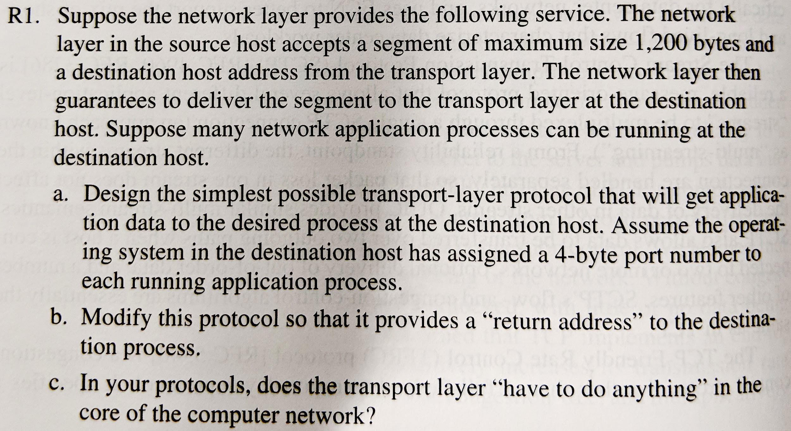

Slide 3
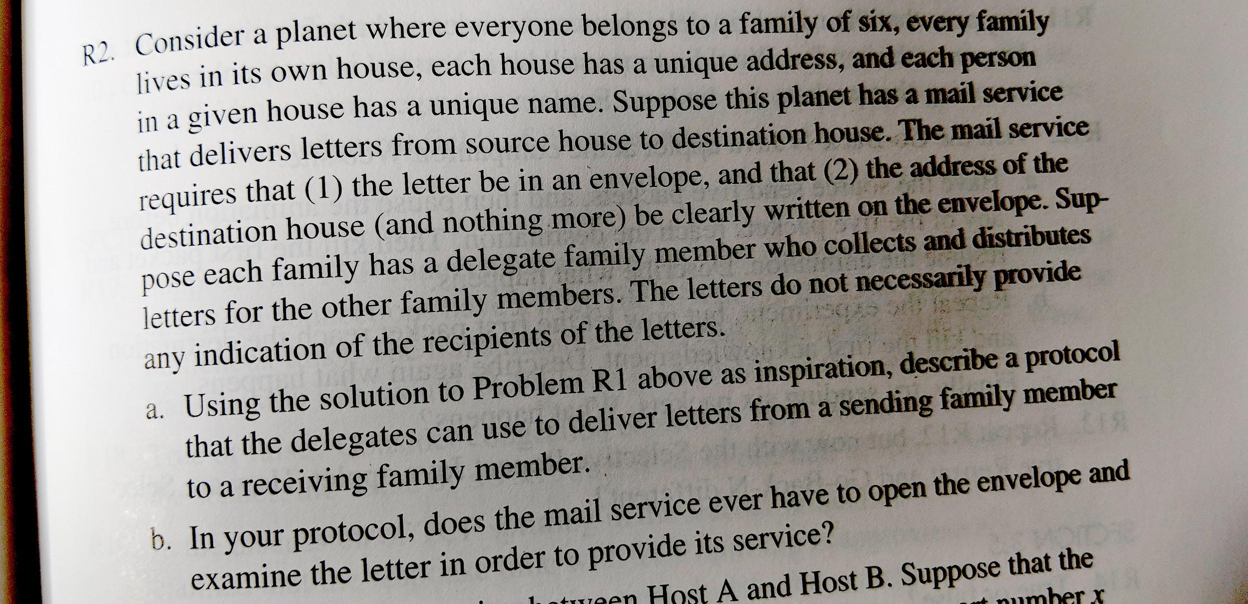

Slide 4
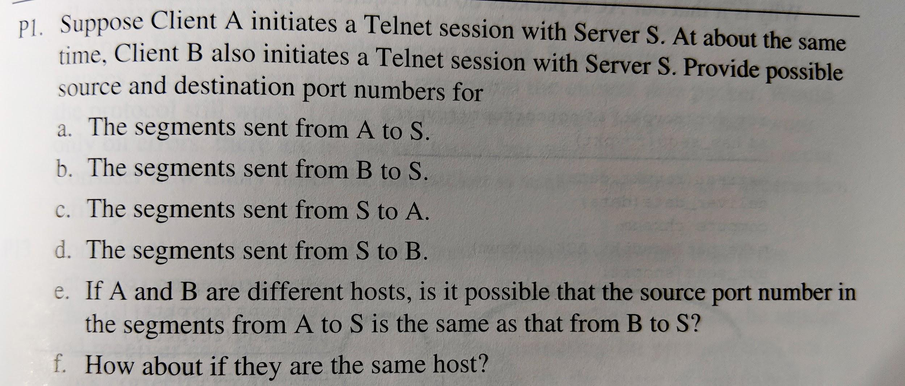

Slide 5
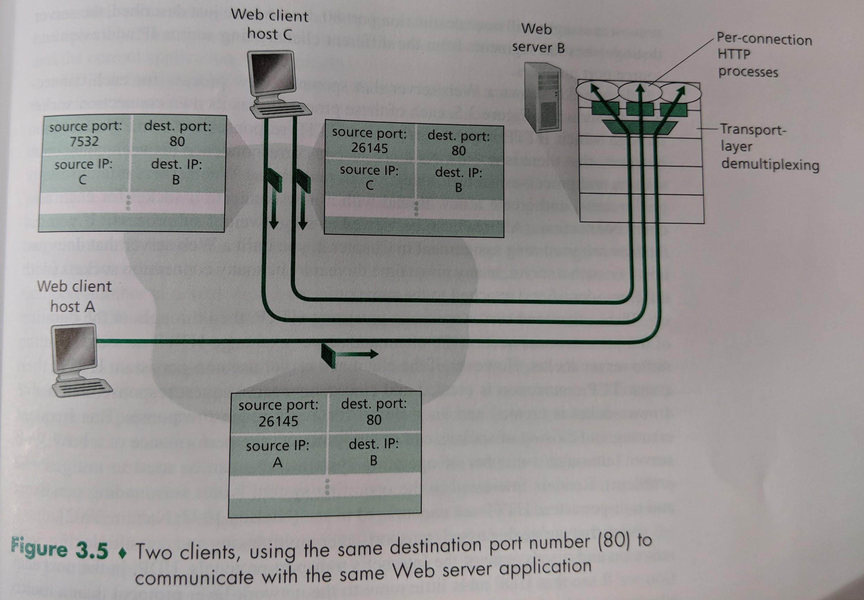
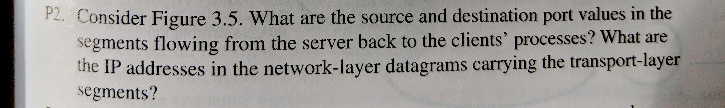

Slide 6
How much difficulty did you have with the server assignment?
It was really easy
I had a tiny bit of difficulty, but easy overall
It was somewhat challenging
It was difficult, but I think I figured it out
I found it very hard

Slide 7
How much difficulty did you have with the client assignment?
It was really easy
I had a tiny bit of difficulty, but easy overall
It was somewhat challenging
It was difficult, but I think I figured it out
I found it very hard

Slide 8
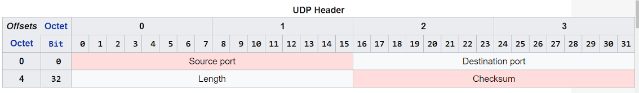
UDP
Last lecture, minimum service required by transport layer is multiplexing, demultiplexing
UDP only provides
Multiplexing & demultiplexing
Extremely basic error checking
We can see this from the UDP transport header

Slide 9
Why use UDP?
Want finer application-level control over what data is sent, and when
No connection establishment
No connection state
Small packet header overhead

Slide 10
Finer Application-Level Control
UDP immediately packages segments and passes them to the network layer
TCP has congestion control mechanisms that can delay sending
TCP will also resend dropped packets, regardless of how long it takes. This is non-ideal for most real-time apps

Slide 11
No Connection Establishment
We can skip the extra RTT required for connection establishment
DNS runs over UDP to avoid the connection establishment requirement

Slide 12
No Connection State
TCP has to keep track of system state in the end systems (sender, receiver)
Requires end systems to have send + receive buffers, congestion control parameters, sequence numbers, …
Higher memory, computation overhead on sender and receiver

Slide 13
Small Packet Overhead
UDP header only requires 8 bytes, TCP header requires 20 bytes. This can add up over time

Slide 14
Other Notes about UDP
UDP is sometimes banned by server administrators due to:
Security issues (see Ch 8)
Negative effects on TCP traffic due to congestion
It IS possible for applications to have Reliable Data Transfer running over UDP, they just have to implement this themselves

Slide 15
UDP Error Checking
Besides multiplexing, UDP provides basic error checking
Done using the UDP checksum
Send performs the 1s complement of the sum of all 16-bit words in the segment and puts this in the checksum field
Receiver also sums all 16-bit words and adds them to the checksum. If any 0’s result, then an error occured

Slide 16
Sum 16 bit words
Segment is a bunch of bits, can be split into 16 bit pieces
Add those pieces together
1 1 1 0 0 1 1 0 0 1 1 0 0 1 1 0 + 1 1 0 1 0 1 0 1 0 1 0 1 0 1 0 1
= 1 1 0 1 1 1 0 1 1 1 0 1 1 1 0 1 1
= 1 0 1 1 1 0 1 1 1 0 1 1 1 1 0 0
Perform the 1’s complement (i.e. replace 0 with 1, 1 with 0)
= 0 1 0 0 0 1 0 0 0 1 0 0 0 0 1 1
Receiver performs sum, adds to checksum, contains 16 1s if no errors

Slide 17
Determine if the following UDP packet has an error
Bits received by the rcvr: 0 0 0 0 1 1 0 0 0 1 0 1 0 0 1 0 | 0 0 0 0 0 0 0 0 0 0 1 1 0 1 0 1 0 0 0 0 0 0 0 0 0 0 0 0 1 1 1 0 | 0 1 0 0 0 1 0 0 1 0 1 1 0 1 0 0 0 0 1 1 1 0 1 1 0 0 1 1 0 1 1 0 | 0 1 1 1 0 0 1 1 1 0 0 0 0 0 0 0
Has an error
Does not have an error
UDP Header
Data
You may use: https://www.exploringbinary.com/binary-converter/, or other binary-to-decimal converter
Notes:
Total d_trans = 10.1 Mb/1Mbps = 10.1 seconds
11 connections to server needed, in serial = 11 * 2RTT = 44 seconds
Total = 54.1 seconds

Slide 18
Before Next Class
Read Section 3.1 - 3.4.1 (this + next class’ material)
Complete HW 2.1
Finish Web Client and Server assignments, due on 10/1

